Slide 1
Chapter 13: Urban Development as Exchange
The New Science of Cities, Michael Batty, MIT Press, Nov. 2013.
BLG 556E - Digital Solutions for Smart Cities
Tugrul Yatagan
yatagan@itu.edu.tr

Slide 2
Outline
Introduction
An Equilibrium Model
An Outline of the Land Development Model
The Battle for Tolmers Square
Structuring the Problem
Applications and Predictions

Slide 3
Introduction
An Equilibrium Model
An Outline of the Land Development Model
The Battle for Tolmers Square
Structuring the Problem
Applications and Predictions
Introduction
Idea of exchange;
The notion that for a system to be in equilibrium.
Its agents must adjust their demands to the supplies controlled by other agents or vice versa.
Perfect market (in theory);
Both demand and supply adjust to the point where a balance occurs and all agents are satisfied that no further improvement.
Price is the signature of this balance.
Process of adjustment for an equilibrium is likely to be one of trial and error (where convergence is assured).
The system moves seamlessly to an equilibrium where all actors (or their representation as factors) achieve a consensus (Coleman’s theory of collective action).
Demand and supply are the basis of economic exchange.
Notes:
Exchange is

Slide 4
Introduction
An Equilibrium Model
An Outline of the Land Development Model
The Battle for Tolmers Square
Structuring the Problem
Applications and Predictions
Introduction
This chapter focus on;
Conflict between agents with an interest and control over the land market.
How these ideas makes agents to reach an equilibrium where land is actually exchanged?
Develop a model of urban development that treats actors or agents more literally as agents of change in the urban system.
The process of change in land ownership will first be considered as a process of economic exchange.
Equilibrium system structural characteristic is examined with exchange processes.
Examine an application to land development in north Central London.
Actually on a historical urban conflict.
The crisis over property speculation in Tolmers Square (1973).

Slide 5
Introduction
An Equilibrium Model
An Outline of the Land Development Model
The Battle for Tolmers Square
Structuring the Problem
Applications and Predictions
An Equilibrium Model
Well-known model of economic exchange;
Individual actors increase their overall levels of satisfaction by trading commodities they have control over for other commodities they desire.
General economic equilibrium is essential for market exchange and for an efficient allocation of resources.
Model stated in two ways:
A set of formal accounting relations.
A set of input-output equations.
Market for land represents one of the most well-defined of all economic markets.
Almost literal exchange for other land or cash through the finance market.
Notes:
An Equilibrium Model aproach is
Easy to model

Slide 6
Introduction
An Equilibrium Model
An Outline of the Land Development Model
The Battle for Tolmers Square
Structuring the Problem
Applications and Predictions
An Equilibrium Model
Tolmers Square model attempts to simulate;
The invasion of one land use over another.
More “profitable” land uses are expanding into areas of less-than-profitable use.
Expansion of offices around central areas of major cities, invading the poor, inner areas is the classic example.
Poorer tenants confronted by “rich” property speculators wishing to own those plots with the resources to “tempt” occupiers to sell or leave.
Local governments wishing to own the land to comprehensively redevelop it.
With the powers to do so in principle.
Inability to do so in practice.
Severe conflict of interests and ideologies.
The essence of exchange;
Conflict between;
What people actually own.
What they desire to own.
Assume that each actor initially has a budget;
Level of resources fixed by what they control.
Notes:
For example expansıon

Slide 7
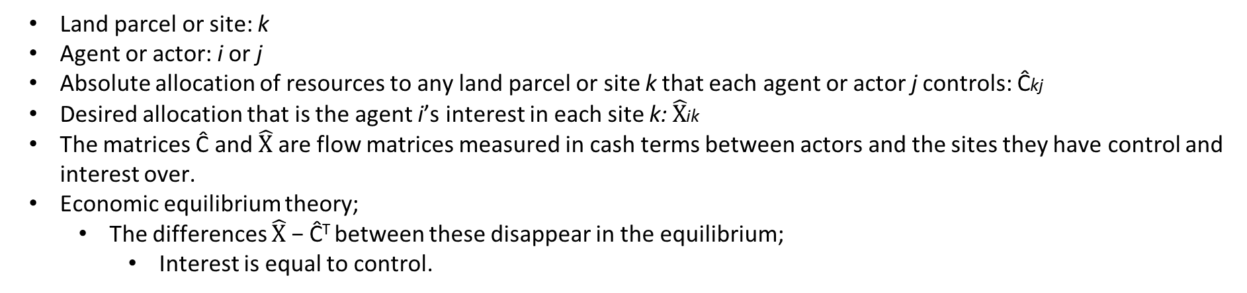
Introduction
An Equilibrium Model
An Outline of the Land Development Model
The Battle for Tolmers Square
Structuring the Problem
Applications and Predictions
An Equilibrium Model
Land parcel or site: k
Agent or actor: i or j
Absolute allocation of resources to any land parcel or site k that each agent or actor j controls: Ĉkj
Desired allocation that is the agent i’s interest in each site k: $\hat{X}$ik
The matrices Ĉ and $\hat{X}$ are flow matrices measured in cash terms between actors and the sites they have control and interest over.
Economic equilibrium theory;
The differences $\hat{X}$ − Ĉ^{T} between these disappear in the equilibrium;
Interest is equal to control.
Notes:
Some terminology

Slide 8
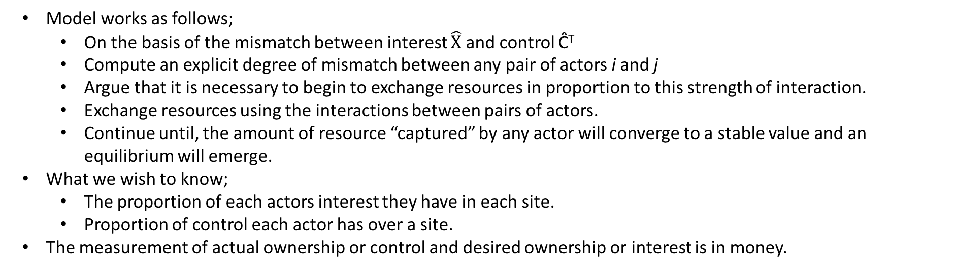
Introduction
An Equilibrium Model
An Outline of the Land Development Model
The Battle for Tolmers Square
Structuring the Problem
Applications and Predictions
An Equilibrium Model
Model works as follows;
On the basis of the mismatch between interest $\hat{X}$ and control Ĉ^{T}
Compute an explicit degree of mismatch between any pair of actors i and j
Argue that it is necessary to begin to exchange resources in proportion to this strength of interaction.
Exchange resources using the interactions between pairs of actors.
Continue until, the amount of resource “captured” by any actor will converge to a stable value and an equilibrium will emerge.
What we wish to know;
The proportion of each actors interest they have in each site.
Proportion of control each actor has over a site.
The measurement of actual ownership or control and desired ownership or interest is in money.

Slide 9
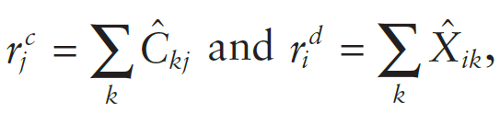
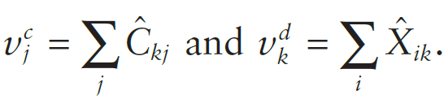
Introduction
An Equilibrium Model
An Outline of the Land Development Model
The Battle for Tolmers Square
Structuring the Problem
Applications and Predictions
An Outline of the Land Development Model
Total resources of each actor associated with control and interest;
Total value of the sites;
The total money M associated with these investments;

Slide 10

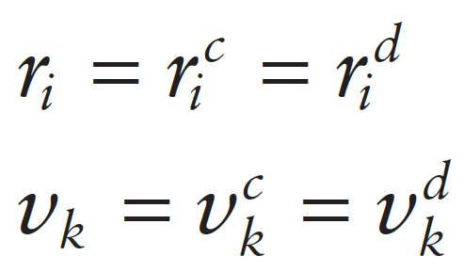
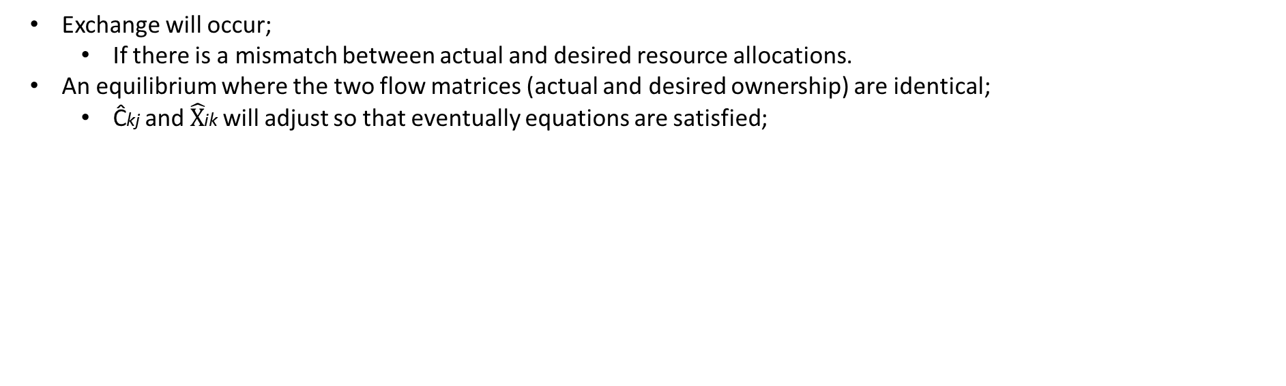
Introduction
An Equilibrium Model
An Outline of the Land Development Model
The Battle for Tolmers Square
Structuring the Problem
Applications and Predictions
An Outline of the Land Development Model
Exchange will occur;
If there is a mismatch between actual and desired resource allocations.
An equilibrium where the two flow matrices (actual and desired ownership) are identical;
Ĉkj and $\hat{X}$ik will adjust so that eventually equations are satisfied;

Slide 11
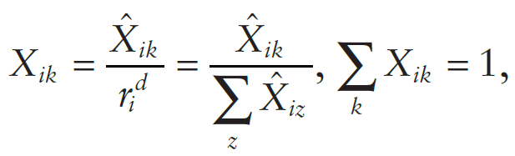
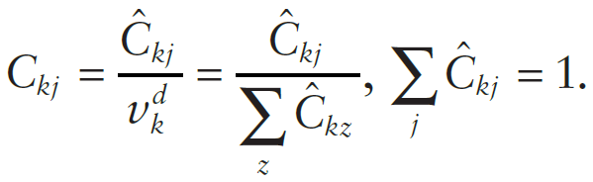
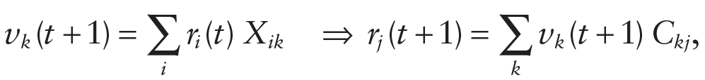
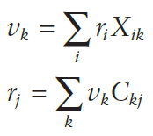
Introduction
An Equilibrium Model
An Outline of the Land Development Model
The Battle for Tolmers Square
Structuring the Problem
Applications and Predictions
An Outline of the Land Development Model
Relative interest Xik
Relative control Ckj
The model can now be formulated and solved as the two-stage process described in previous section.
Iterative two-step process;
Model start with resources ri (t = 1) and effect the continued substitutions until we reach some limit of convergence;

Slide 12
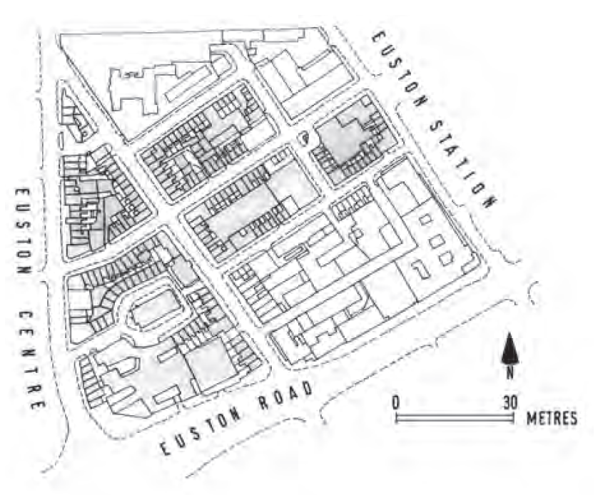
Introduction
An Equilibrium Model
An Outline of the Land Development Model
The Battle for Tolmers Square
Structuring the Problem
Applications and Predictions
The Battle for Tolmers Square
Tolmers Square is an area of north Central London.
A company called “Stock Conversion” built up enormous assets based on the profits of property speculation (1973).
Stock Conversion was;
Buying properties in the Tolmers Square area as early as 1962.
Owned well over half the area of interest by 1974.
Local authority prepared series of planning schemes but failed;
Because of the excessive cost of compulsory purchase.
Local authority tries to negotiate with Stock Conversion to agree a joint development.
Residents opposed. A local pressure group was formed.
Local authority finally decided to buy out Stock Conversion’s interest and undertake a more socially relevant development for the area.

Slide 13
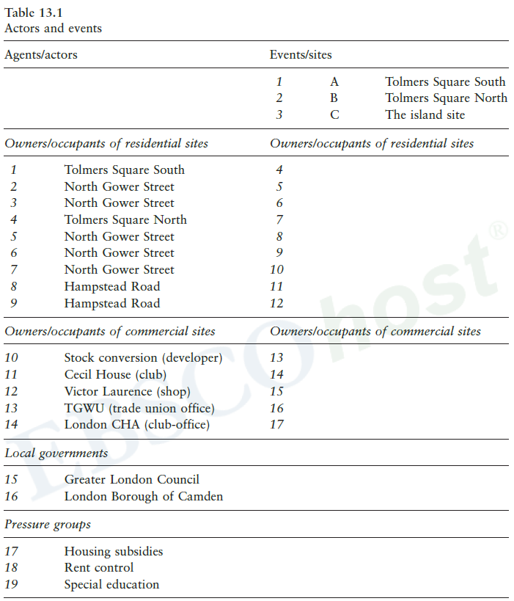
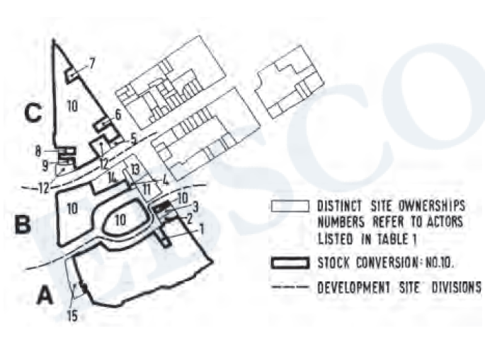
Introduction
An Equilibrium Model
An Outline of the Land Development Model
The Battle for Tolmers Square
Structuring the Problem
Applications and Predictions
Structuring the Problem
Intended goal is to simulate this change in Camden’s policy toward their ownership of land as a switch in control within the exchange model.
There are at least 132 actors and 62 sites.
We model a smaller, simplified representation of the conflict.

Slide 14
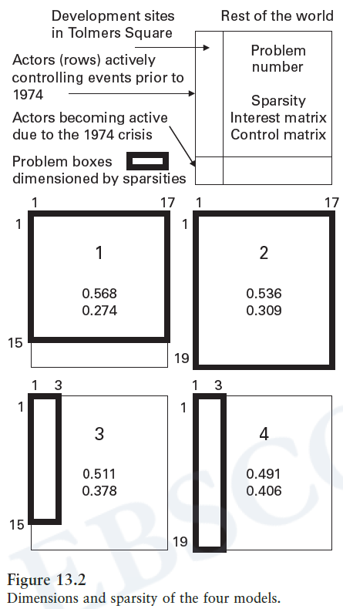
Introduction
An Equilibrium Model
An Outline of the Land Development Model
The Battle for Tolmers Square
Structuring the Problem
Applications and Predictions
Structuring the Problem
Identify all the actors involved over the time period of interest.
Actors divided into two sets;
Actors in bargaining over land prior to 1973. (pre-1973)
Actors whose “interest” was awakened by the 1973 crisis. (post-1973)
15 actors in the pre-1973 situation all have some control over these 3 sites.
Very large “rest of the world” sector;
For events that enable a type of migration of actors into and out of the system to take place.
Four models;
pre-1973 with rest of the world: actors i = 1, 2, … , 15; sites k = 1, 2, … , 17
post-1973 with rest of the world: actors i = 1, 2, … , 19; sites k = 1, 2, … , 17
pre-1973 without rest of the world: actors i = 1, 2, … , 15; sites k = 1, 2, 3
post-1973 without rest of the world: actors i = 1, 2, … , 19; sites k = 1, 2, 3
These sparsity indices are based on a direct count of positive entries divided by the total possible entries.
Control matrices are sparser than the interest matrices,

Slide 15
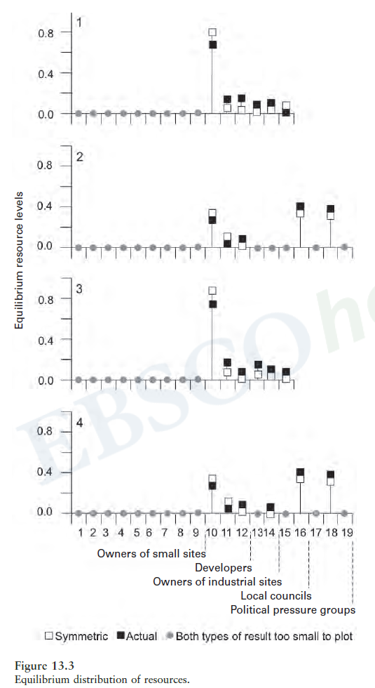
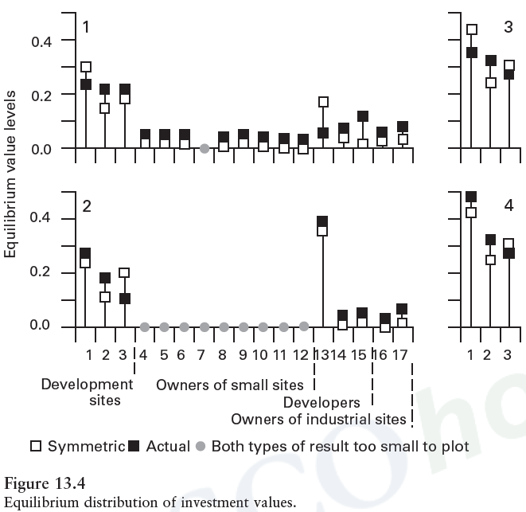
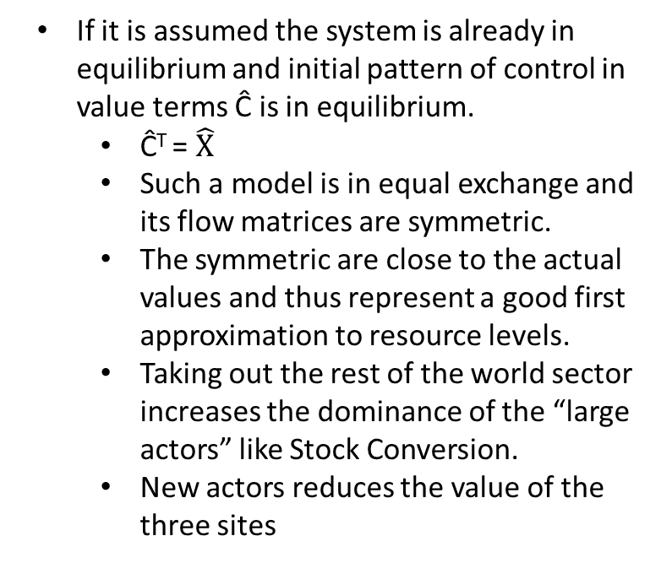
Introduction
An Equilibrium Model
An Outline of the Land Development Model
The Battle for Tolmers Square
Structuring the Problem
Applications and Predictions
Applications and Predictions
If it is assumed the system is already in equilibrium and initial pattern of control in value terms Ĉ is in equilibrium.
Ĉ^{T} = $\hat{X}$
Such a model is in equal exchange and its flow matrices are symmetric.
The symmetric are close to the actual values and thus represent a good first approximation to resource levels.
Taking out the rest of the world sector increases the dominance of the “large actors” like Stock Conversion.
New actors reduces the value of the three sites
Notes:
In the case of the first model 1, the symmetric case gives much greater weight to the Island site and to getting Stock Conversion out of the area case of model 2, the symmetric results are close to the actual. For models 3 and
4 without the rest of the world sectors, all the value is concentrated on the three sites, with the Island site still the most important. It is also worth looking at the exchanges between

Slide 16
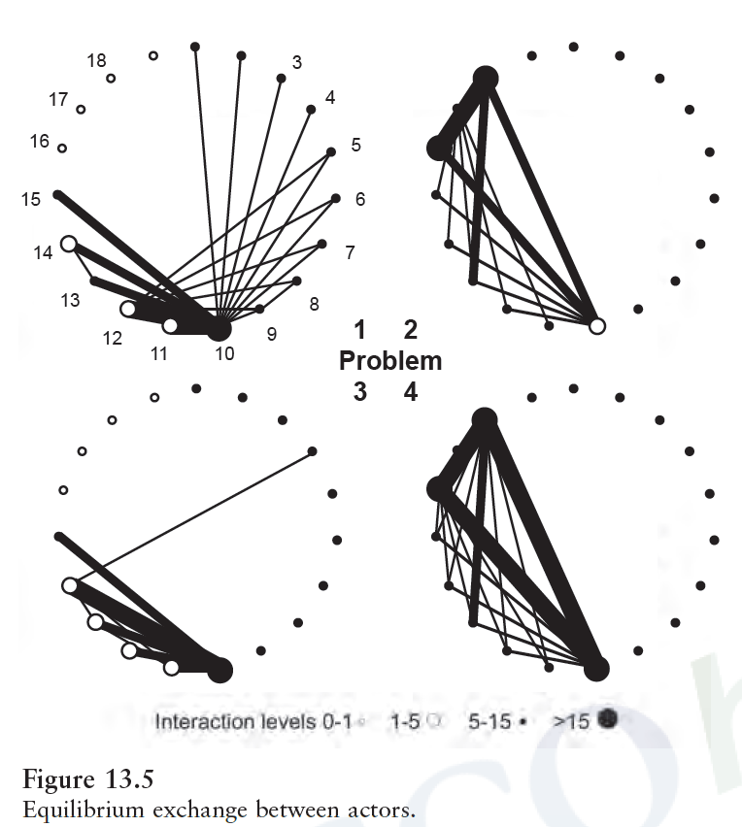
Introduction
An Equilibrium Model
An Outline of the Land Development Model
The Battle for Tolmers Square
Structuring the Problem
Applications and Predictions
Applications and Predictions
These networks show the percentage of resources exchanged and identify the critical actors in this process.
In model 1, Stock Conversion dominates most of the (48%) exchange.
In model 2, Three actors — Stock Conversion, Camden, and Claudius engage in about 70% of the exchange.
When the rest of the world sectors are deleted, patterns of exchange intensify;
In model 3, 63% of trade becomes internal to Stock Conversion.
In model 4, three key actors are involved in 86% of the exchange.

Slide 17
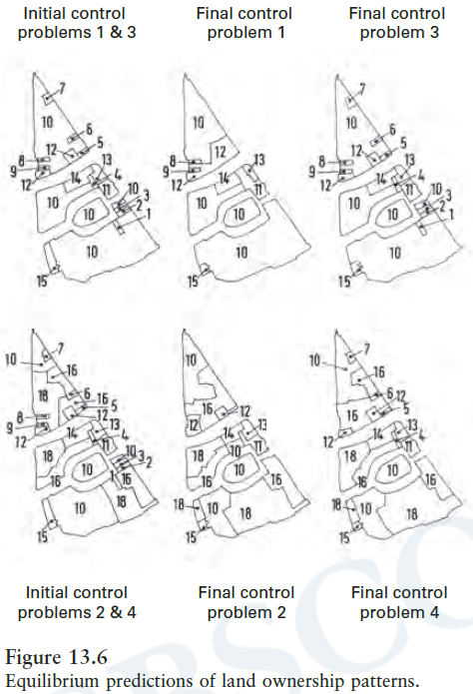
Introduction
An Equilibrium Model
An Outline of the Land Development Model
The Battle for Tolmers Square
Structuring the Problem
Applications and Predictions
Applications and Predictions
Four predicted patterns of land ownership are presented.
In model 1, owners and occupiers disappear at the expense of the property developers.
In model 2, the main interest is that Claudius loses its control over the Island site while increasing its land holdings in Tolmers Square South
In model 3, there is little change from the pattern of initial control without the rest of the world sector.
In model 4, the exclusion of the rest of the world sector leads to less change from the pattern of initial control.
The predictions from these models at least appear consistent with the actual chronicle of events.

Slide 18
Thank you for your time.
Any questions?

